Slide 1
Higher Education in Serbia
Prof. dr Miodrag Popović
University of Belgrade

Slide 2
Legal framework
Law on Higher Education (2005)
Regulates all aspects of higher education except science and research activities.
Amended and revised several times. Major revisions in 2010 and 2014.
Law on Scientific Research (2005)
Regulates science and research activities of higher education institutions.
Amended and revised several times. Major revision in 2015.
Strategy on Education Development until 2020 (Approved by the Government of the Republic of Serbia)
Action plan for implementation of the Strategy (Approved by the Government of the Republic of Serbia)
*

Slide 3
Law on Higher Education
Main principles: Three-cycle structure, two types of studies (academic and professional), introduction of ECTS, licencing, quality assurance, accreditation of institutions and study programs, mobility of students and academic staff, etc.
Governing bodies:
National Council for Higher Education (NCHE), elected by The National assembly
Commission for Accreditation and Quality Assurance (CAQA), elected by the NCHE
Conference of Serbian universities
Conference of Serbian high schools
Student conference of Serbian universities
Student conference of Serbian high schools
*

Slide 4
Bylaws (Approved by The Ministry of Education, Science and Technological Development)
Decree of normatives and standards for work conditions in universities and faculties for activities which are financed from the budget (2002)
Decree of issuing of public certificates
etc
*

Slide 5
Bylaws (Approved by The National Council of Higher Education)
Rules and Regulations on accreditation standards and procedures of higher education institutions and study programs (2006)
List of professional, academic and scientific titles with the indication of occupation in respective degrees
Rules and Regulations on self-assessment and quality review of higher education institutions (2006)
Rules and Regulations of external quality control of higher education institutions and procedure for external quality control in the higher education institutions (2006)
etc.
*

Slide 6
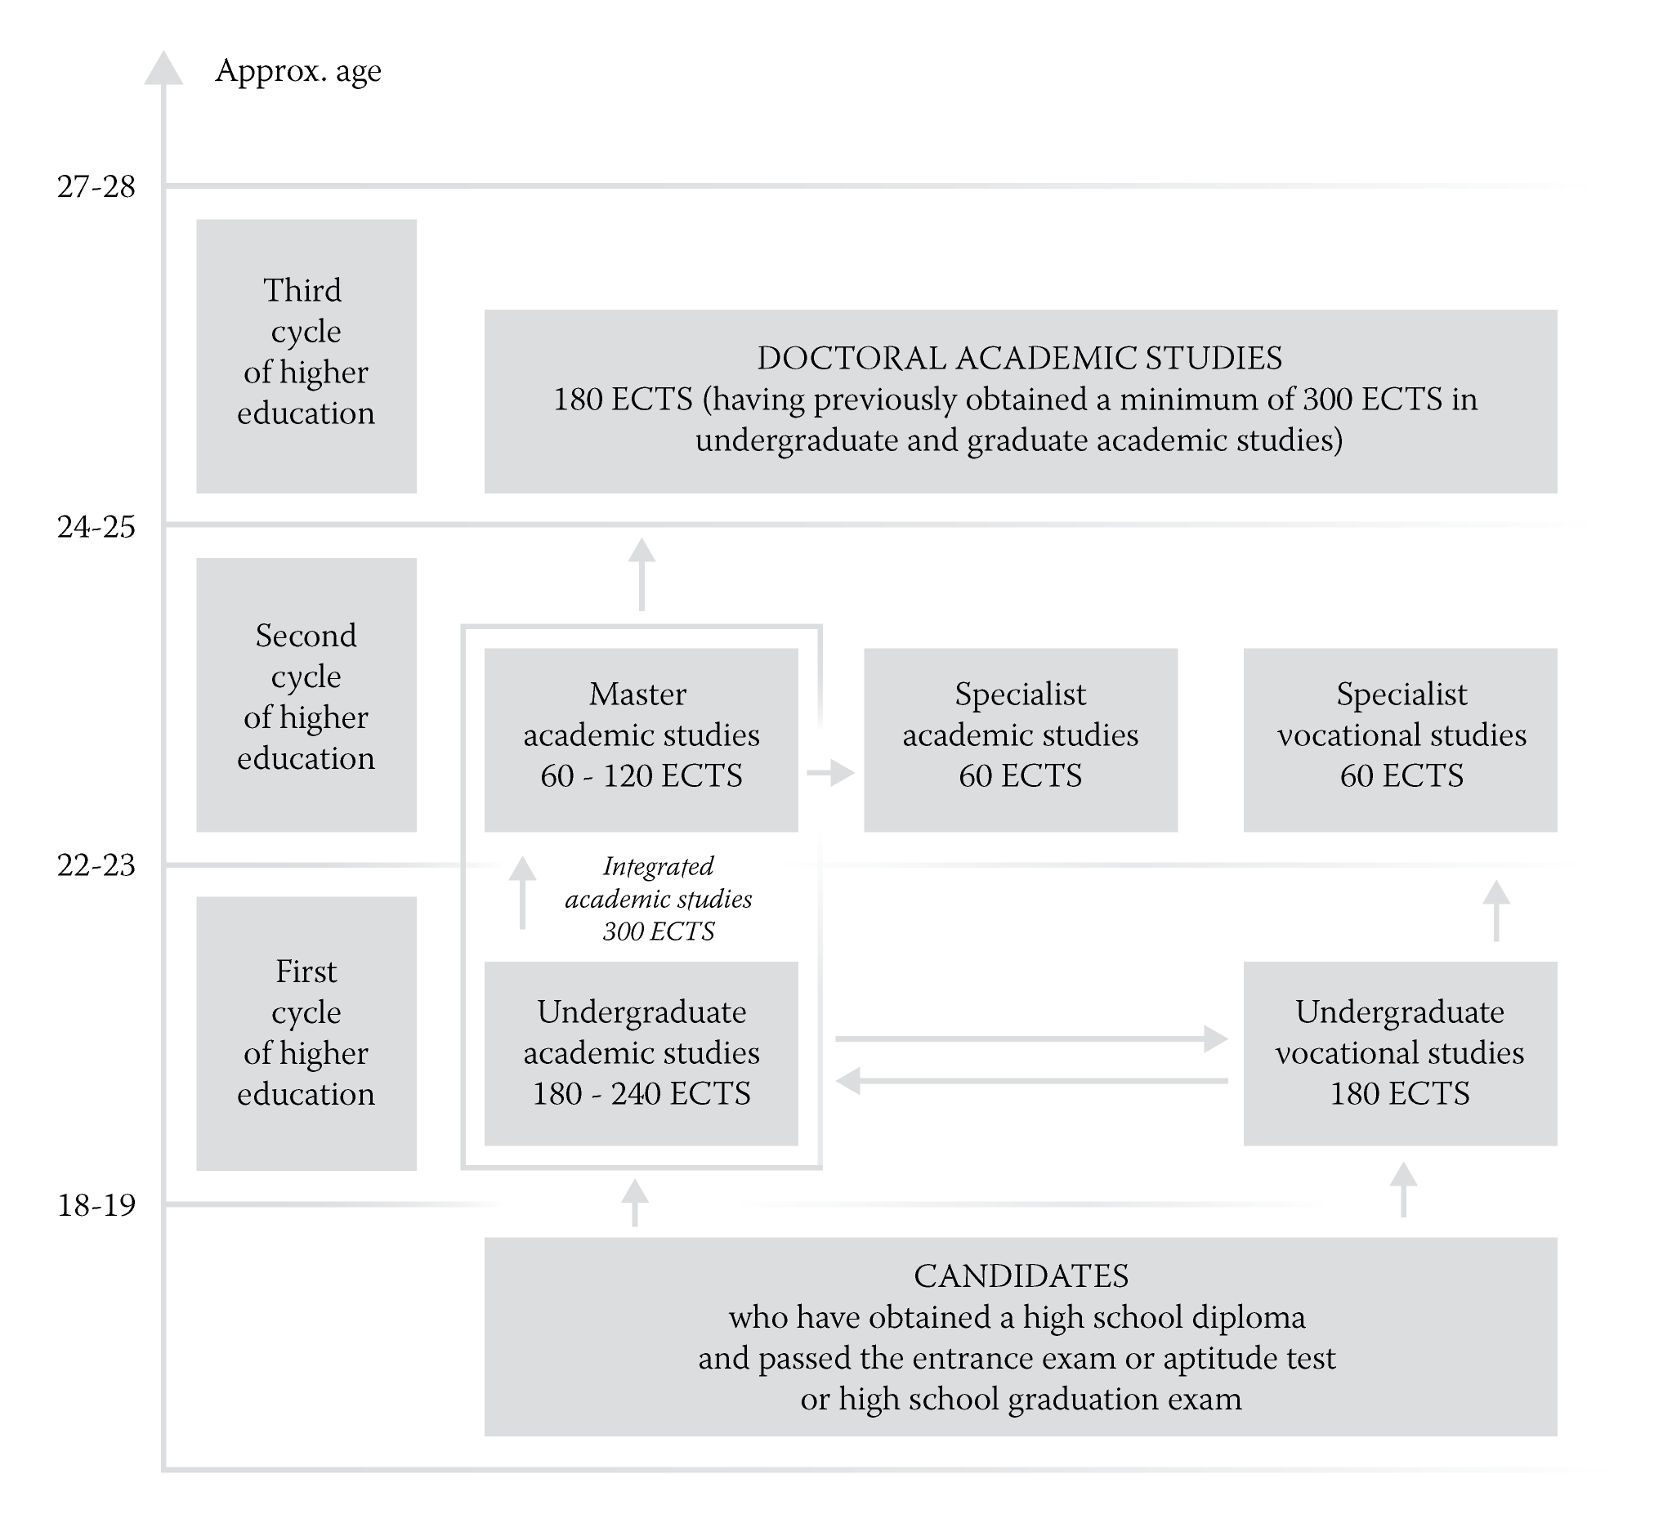
Structure of Higher education in Serbia
*

Slide 7
National Qualification Framework
8 levels of qualification
Levels 6, 7 and 8 are devoted to the Higher education
Level 6.1: bachelor academic studies, 180 ECTS
bachelor professional studies, 180 ECTS
Level 6.2: bachelor academic studies, 240 ECTS)
specialist professional studies, 180+60 ECTS
Level 7.1: master academic studies, 180+120 ECTS or 240+60 ECTS
master professional studies, 180+120 ECTS
integrated master academic studies, up to 360 ECTS
Level 7.2: specialist academic studies, 60 ECTS
Level 8.2: doctoral academic studies, 180 ECTS
*

Slide 8
Some facts about HED in Serbia
8 public and 9 private universities
Big universities (Belgrade, Novi Sad, Niš, Kragujevac) are not fully integrated (faculties can be legal entities)
About 240 000 students
Description of the Serbian education system is available in Eurydice https://webgate.ec.europa.eu/fpfis/mwikis/eurydice/index.php/Serbia:Higher_Education

Slide 9
Structure of income of universities and faculties
Financing from the budget (only for universities founded by the state)
Scholarships from students which should pay for their study
Income from national scientific projects
Income from international scientific and educational projects (FP7, Horizon2020, Tempus, Erasmus, etc)
Commercial services to third parties
Income from publishing
Donations

