Slide 1
WP5.1 Development of Curricula & Course Syllabi Pilot Online SCHE Program PROGRAMING IN JAVA
Dragan Domazet
Belgrade Metropolitan University

Slide 2
What is the job of a java programmer?
First, let try to find the answer to the following question:

Slide 3
Starting References
E-Competence Framework (e-CF):
http://profiletool.ecompetences.eu/
European ICT Professional Profiles (CWA 16458)
http://www.ecompetences.eu/ict-professional-profiles/
Foundational ICT Body of Knowledge
http://www.digitaleurope.org/SearchResults.aspx?Search=Foundational%20ICT%20Body%20of%20Knowledge

Slide 4
E-Competence Framework (e-CF)
The e-CF supports the definition of jobs, training courses, qualifications, career paths, formal and non-formal learning paths, certifications etc. in the ICT sector.

Slide 5
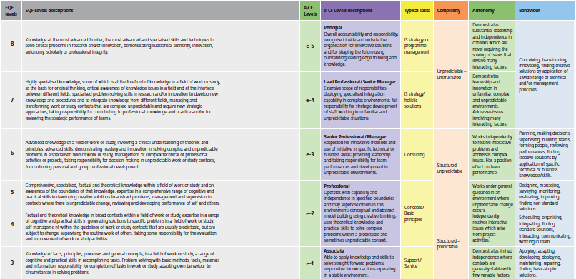
European e-CF and EQF level table
SCHE Program
Java Senior Programmer
SCHE Program
Java Programmer

Slide 6
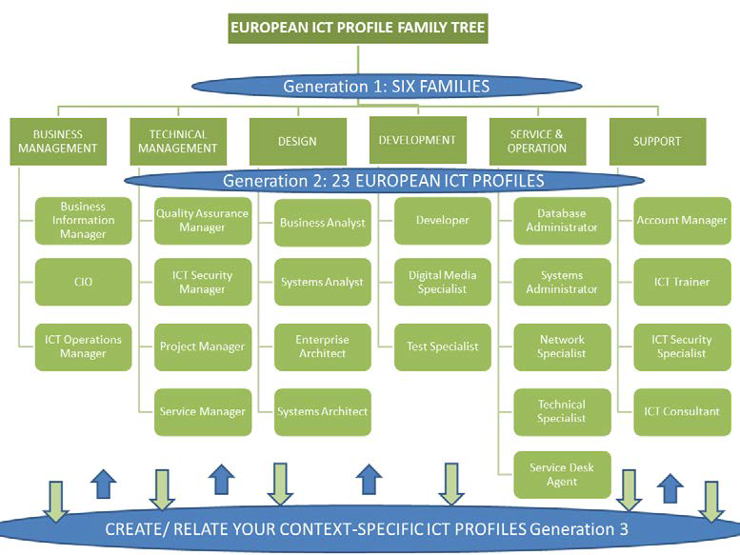
23 Job Profiles

Slide 7
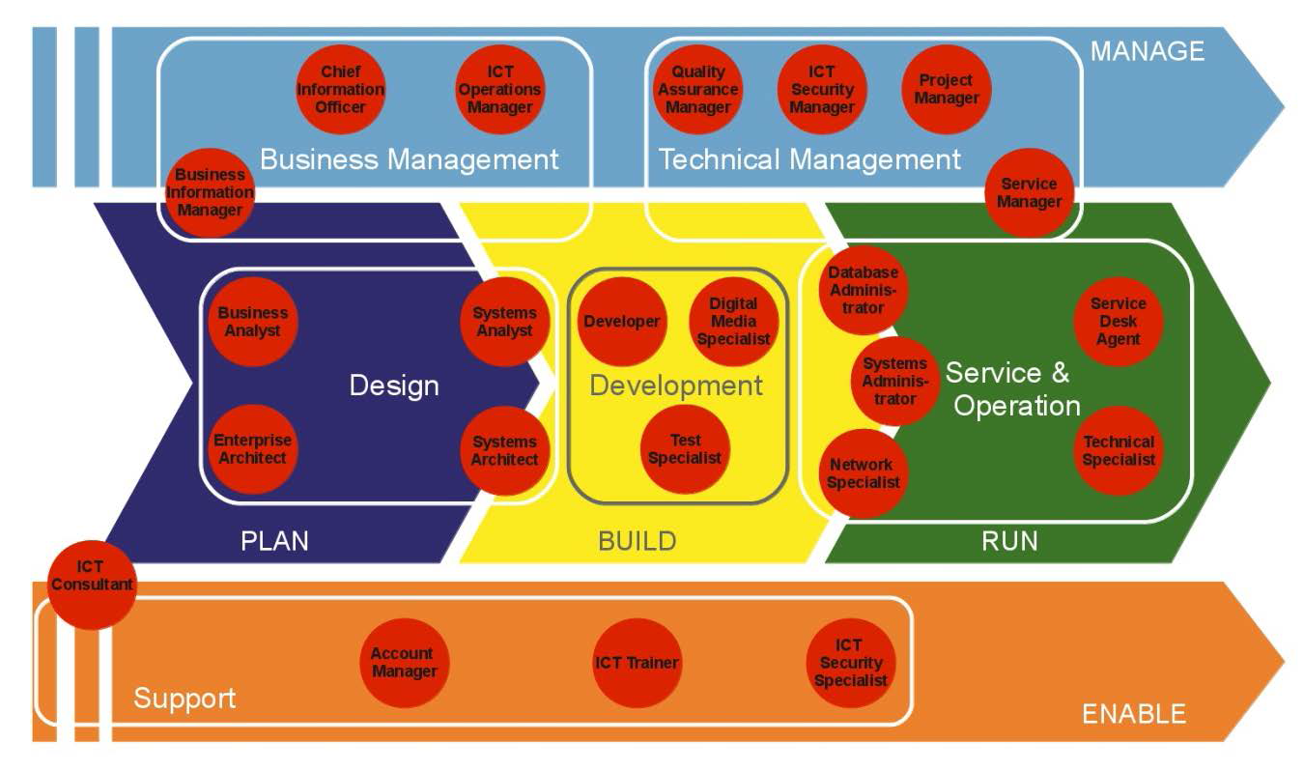
23 Job Profiles

Slide 8
Java Developer as the 3rd Level of the European ICT Professional Profiles
DEVELOPMENT
1. nivo
Digital Media Specialist
Developer
Test Specialist
2. nivo
Java Developer (Java programer)
3.nivo
Java programer – radno mesto definisano na 3. nivu evropskih ICT profesionalnih profila (radnih mesta)

Slide 9
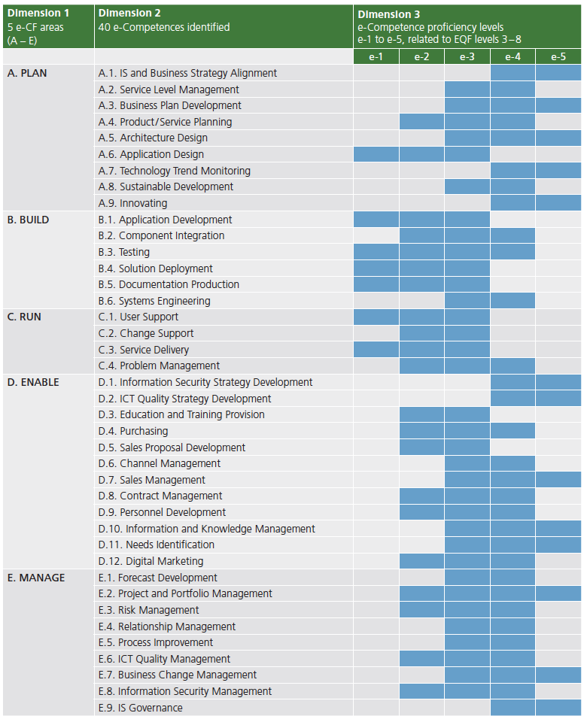
40 e-Competences

Slide 10
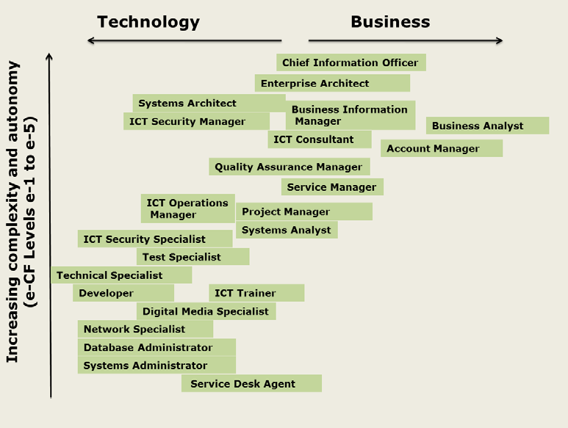

Slide 11
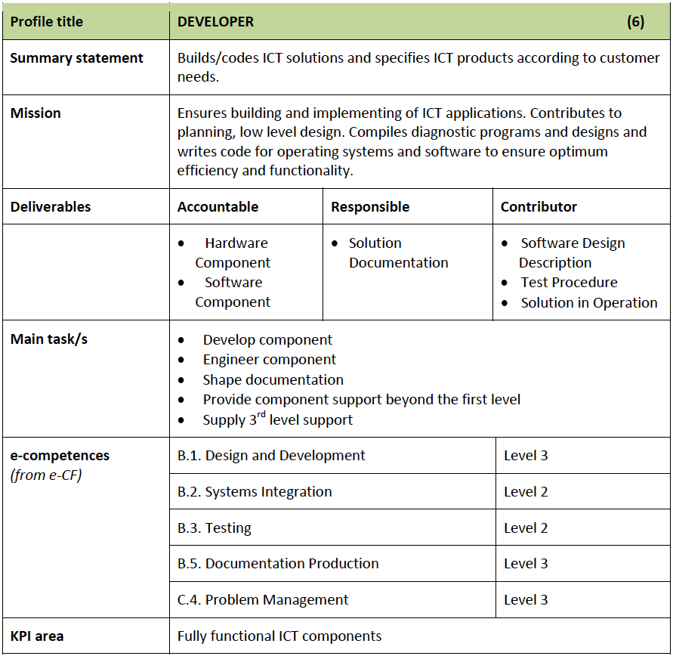
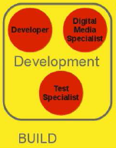

Slide 12
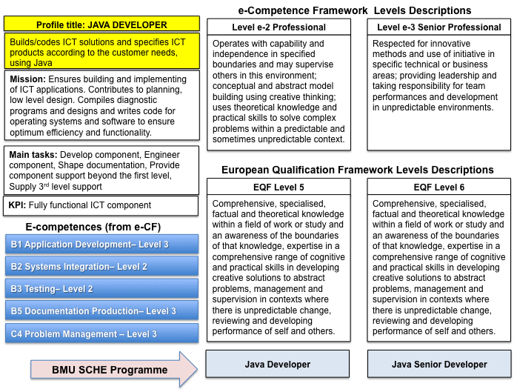

Slide 13
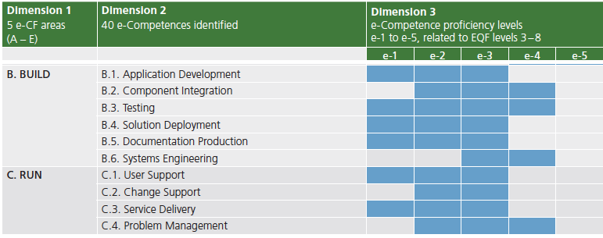
Competences of a Developer
e-Comptetence levels: e-2 & e-3
EQF levels: 5 & 6

Slide 14
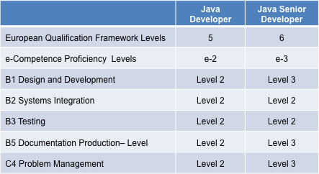
EQF & e-Competence Levels

Slide 15
8
EQF
Level
7
SCHE Program
JAVA SENIOR DEVELOPER
6
SCHE Program
JAVA DEVELOPER
B1 Application Development
B5 Document Production
C4 Problem Management
5
B1 Application Development
B5 Document Production
C4 Problem Management
B2 Component Integration
B3 Testing
SCHE Program
JAVA JUNIOR DEVELOPER
4
3
B1 Application Development
B5 Document Production
B3 Testing
e-Competence
proficiency levels
e-1
e-2
e-3

Slide 16
EQF/e-Competence Program Positioning
8
EQF
Level
7
6
Java Senior Developer
5
Java Developer
4
3
e-Competence
proficiency levels
e-1
e-2
e-3
e-4
e-5

Slide 18
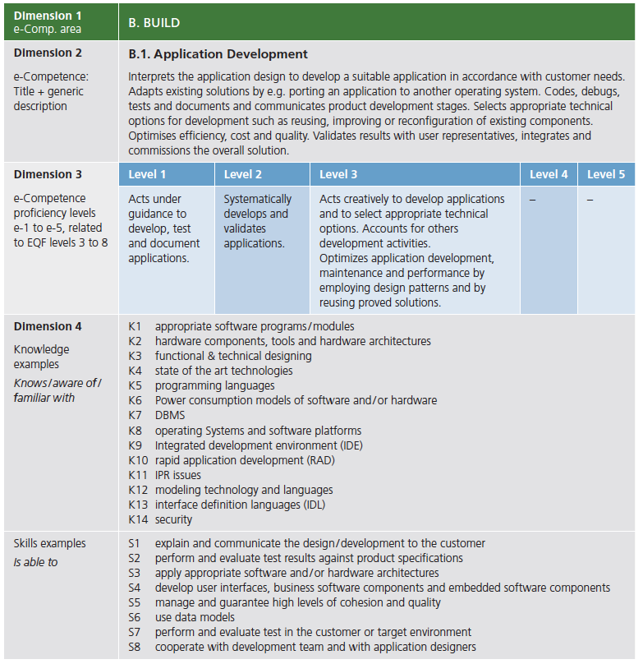

Slide 19
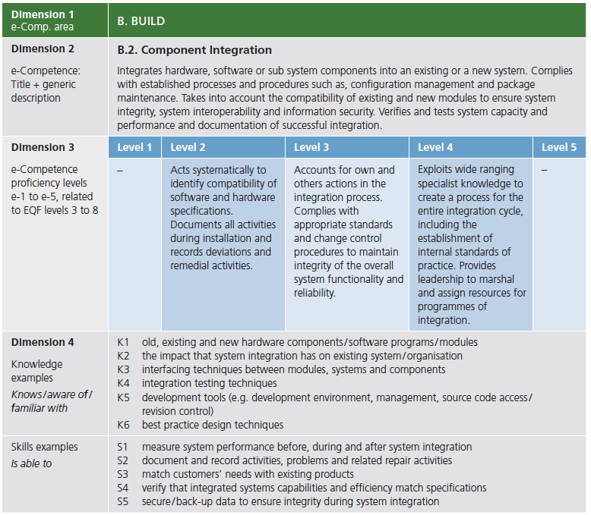

Slide 20
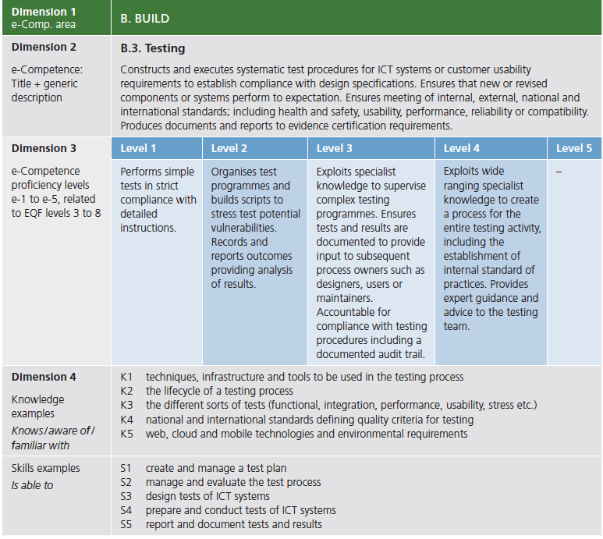

Slide 21
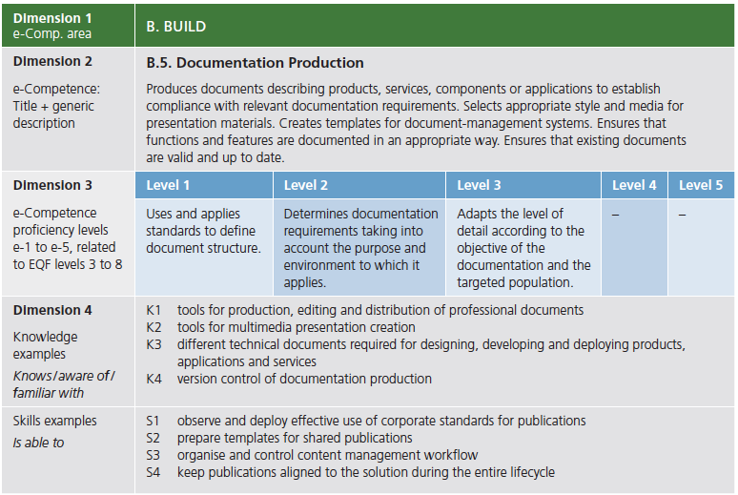

Slide 22
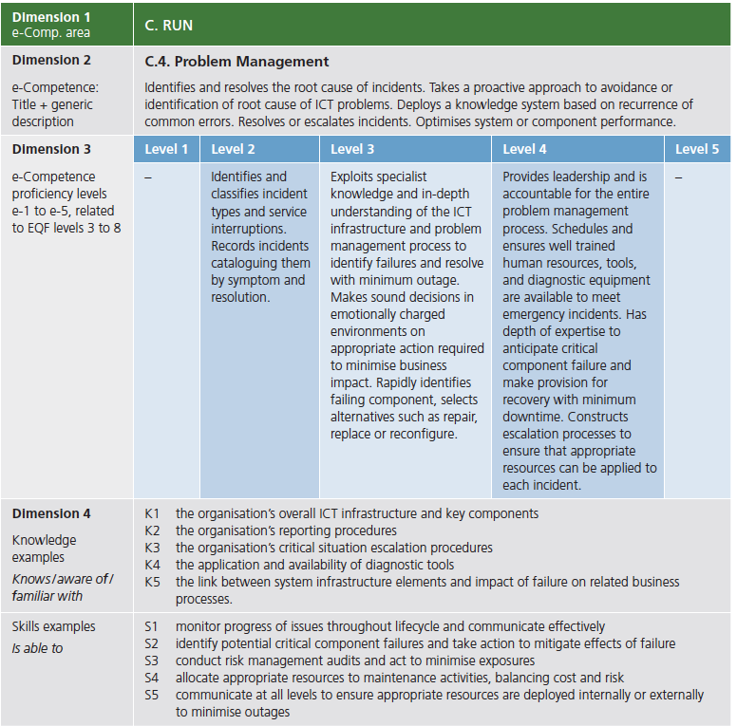

Slide 23
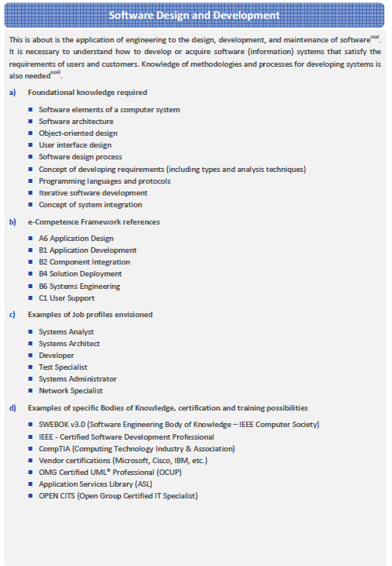
Body of Knowledge (BOK) for:
Software Design and Development
P. Bourque and R.E. Fairley, eds., Guide to the Software Engineering Body of Knowledge, Version 3.0, IEEE Computer Society, 2014; www.swebok.org.

Slide 24
Mapping e-Competences into BMU SCHE Courses
e-Competences
BMU Bachelor Courses
BMU SCHE Courses
Software Engineering Body of Knowledge, Version 3.0, IEEE Computer Society, 2014
As BMU bachelor courses are based on SWEBOK, their parts of the Body of Knowledge are to be mapped into BMU SCHE courses

Slide 25
SCHE Program JAVA DEVELOPER
Program name: Java Developer (in Serbian: Java Programer)
e-CF Level: e-2
EQF Level: 5
Duration: 12 months
Learning Mode: Online
Qualification: Java Programer (in Serbian)
SCHE Certificate, 60 ECTS

Slide 26
Java developer Curriculum

Slide 27
The Structure of a SCHE Program
Program Certificate
Short Cycle Program
Courses
Course Certificate
Lessons
Learning Objects

Slide 28
Mapping of e-Competences into BMU Courses
e-Competences
BMU Bachelor Courses

Slide 29
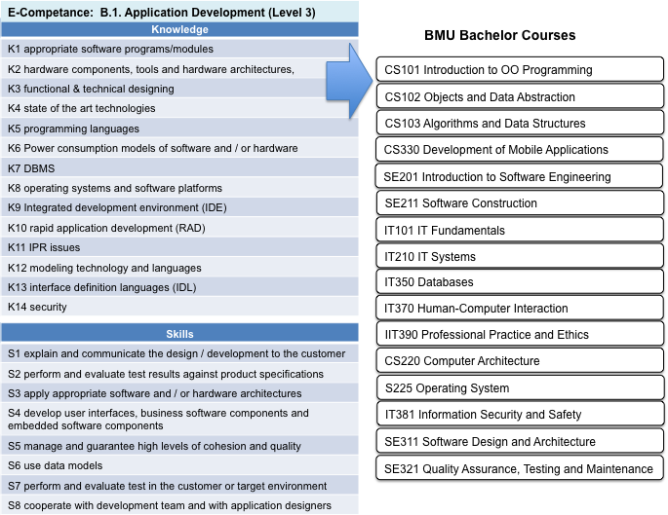
Mapping of e-Competences into BMU Courses

Slide 30
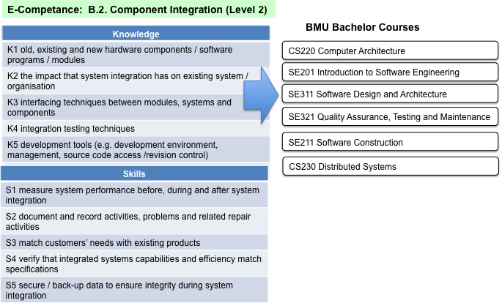
Mapping of e-Competences into BMU Courses

Slide 31
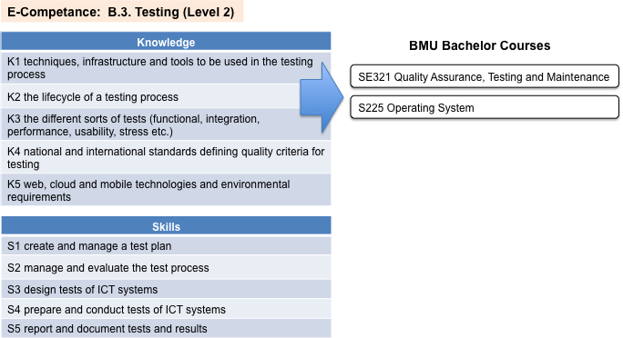
Mapping of e-Competences into BMU Courses

Slide 32
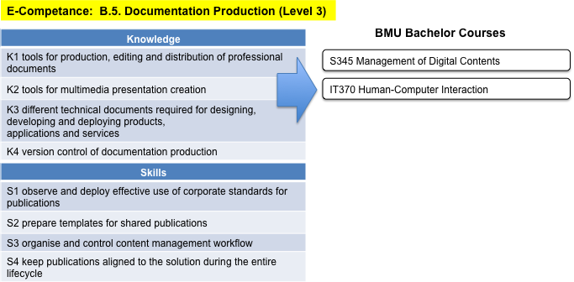
Mapping of e-Competences into BMU Courses

Slide 33
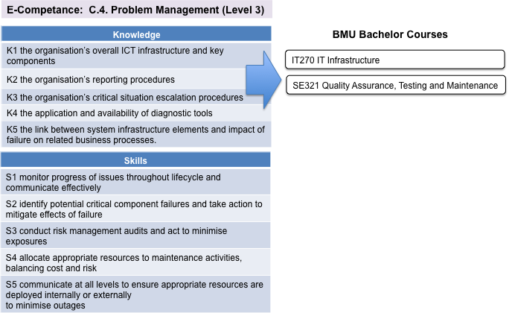
Mapping of e-Competences into BMU Courses

Slide 34
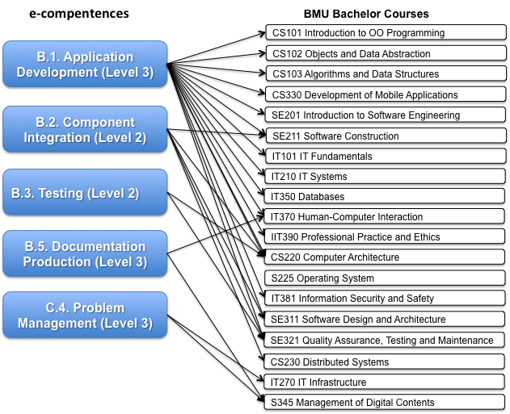
Mapping of e-Competences into BMU Courses

Slide 35
Mapping BMU Courses into BMU SCHE Courses
e-Competences
BMU Bachelor Courses
BMU SCHE Courses

Slide 36
Mapping of BMU Bachelor Courses inti BMU SCHE Courses
BMU Bachelor Courses
BMU SCHE Courses
CS101 Introduction to OO Programming
Introduction to IT Systems
CS102 Objects and Data Abstraction
Programming Fundamentals
CS103 Algorithms and Data Structures
CS330 Development of Mobile Applications
JAVA 1: Fundamentals of Programming
SE201 Introduction to Software Engineering
JAVA 2: Object-Oriented Programming
SE211 Software Construction
JAVA 3: GUI and Graphics Programing
IT101 IT Fundamentals
IT210 IT Systems
JAVA 4: Data Structures and Algorithms-Part A
IT350 Databases
JAVA 5: Data Structures and Algorithms-Part B
IT370 Human-Computer Interaction
IIT390 Professional Practice and Ethics
JAVA 6 : Advanced Java Programming
CS220 Computer Architecture
Java 7: Java Enterprise Edition
S225 Operating System
Java 8: Java Programming for Android
IT381 Information Security and Safety
SE311 Software Design and Architecture
Software Development Process and Methodologies
SE321 Quality Assurance, Testing and Maintenance
Software Construction
CS230 Distributed Systems
IT270 IT Infrastructure
Software Development Project
S345 Management of Digital Contents
Internship for Java Developer

Slide 37
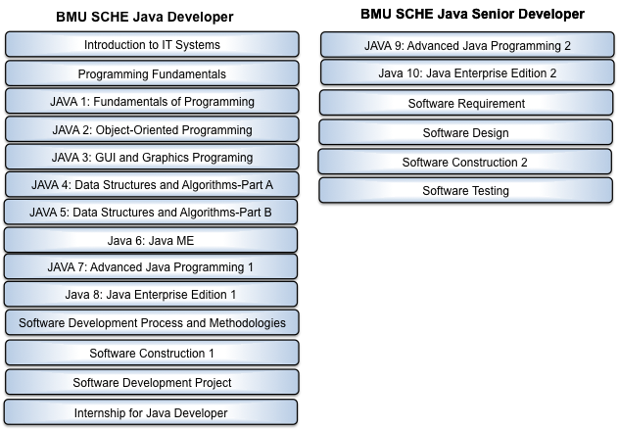
BMU SCHE Program for Java Developer and for Java Senior Development

Slide 38
Duration of 13 Courses (3 hours/day) and Internships (8 weeks)
Introduction to IT Systems
14 online days
Exam day
Programming Fundamentals
8 online days
2 workshop days
Exam day
JAVA 1: Fundamentals of Programming
14 online days
2 workshop days
Exam day
JAVA 2: Object-Oriented Programming
10 online days
2 workshop days
Exam day
JAVA 3: GUI and Graphics Programing
14 online days
2 workshop days
Exam day
JAVA 4: Data Structures and Algorithms-Part A
13 online days
2 workshop days
Exam day
JAVA 5: Data Structures and Algorithms-Part B
13 online days
2 workshop days
Exam day
JAVA 6 : Advanced Java Programming
12 online days
2 workshop days
Exam day
Java 7: Java Enterprise Edition
21 online days
2 workshop days
Exam day
Software Development Process and Methodologies
15 online days
2 workshop days
Exam day
Software Construction
18 online days
2 workshop days
Exam day
Elective Course
23 online days
Exam day
Internship for Java Developer
8 working weeks
Exam day

Slide 39
List of courses, their duration, & learning hours
# | Course | Duration (Days) | Online Learning Days | Workshop Days (3hrs/day) | Learning Hours (3hrs/days) | ECTS | Note
1 | KI101 Introduction to IT systems | 15 | 14 | 0 | 42 | 4 | No workshops
2 | KI102 Programming Fundamentals | 11 | 8 | 2 | 30 | 3 | 2 days workshops
3 | KI103 Java 1: Fundamentals of Programming | 17 | 14 | 2 | 48 | 5 | 2 days workshops
4 | KI104 Java 2: Object-oriented programming | 13 | 10 | 2 | 36 | 3 | 2 days workshops
5 | KI105 Java 3: GUI Programming | 17 | 14 | 2 | 48 | 4 | 2 days workshops
6 | KI201 Java 4: Data Structures and Algorithms – Part A | 16 | 13 | 2 | 45 | 4 | 2 days workshops
7 | KI202 Java 5: Data Structures and Algorithms – Part B | 16 | 13 | 2 | 45 | 4 | 2 days workshops
8 | KI203 Java 6: Advanced Java Programming | 15 | 12 | 2 | 42 | 4 | 2 days workshops
9 | KI204 Java 7: Java Enterprise Edition | 24 | 21 | 2 | 69 | 7 | 2 days workshops
10 | KI206 Software Development Process and Methodologies | 18 | 15 | 2 | 51 | 5 | 2 days workshops
11 | KI301 Software Construction | 21 | 18 | 2 | 60 | 6 | 2 days workshops
12 | Elective Course | 24 | 23 | 0 | 90 | 8 | No workshops
13 | KI402 Internship (8 weeks) | 40 | 0 | 0 | 0 | 3 | No workshops
 | Agregate: | 247,0 | 175,0 | 20,0 | 606 | 60 | 32workshop days

Slide 40
 | SCHE PROGRAMMING IN JAVA
 | Duration: 2.10.2017 - 29.9.2018
 |  | Week Day | M | T | W | T | F | S
1 | KI101 Introduction to IT systems | 2.10.2017
 | Days: 14+0+1, Hours: 41 ECTS: 4 | 9.2.2017
 |  | 16.10.2017 |  |  |  |  |  | KI101
2 | KI102 Programming Fundamenta | 23.10.2017
 | Days: 8+2+1, Hours: 30 ECTS: 3 | 30.10.2017 |  |  |  |  |  | KI102
3 | KI103 Java 1: Fundamentals of Programming | 6.11.2017
 | Days: 14+2+1, Hours: 48 ECTS:5 | 13.11.2017
 |  | 20.11.2017 |  |  |  |  |  | KI103
4 | KI104 Java 2: Object-oriented programming | 27.11.2017
 | Days:10+2+1, Hours: 36 ECTS:3 | 4.12.2017
5 | KI105 Java 3: Programming of users experience | 11.12.2017 |  |  |  |  |  | KI104
 | Days: 14+2+1, Hours: 48 ECTS:4 | 18.12.2017
 |  | 25.12.2017 |  |  |  |  |  | KI105
 | New Year & Christmas Holidays | 1.1.2018
6 | KI201 Java 4: Data Structures and Algorithms – Part A | 8.1.2018
 | Days: 13+2+1, Hours: 45 | 15.1.2018
 | ECTS:4 | 22.1.2018 |  |  |  |  |  | KI201
7 | KI202 Java 5: Data Structures and Algorithms – Part B | 29.1.2018
 | Days:: 13+2+1, Hours: 45 ECTS:4 | 5.2.2018
 |  | 12.2.2018 |  |  |  |  |  | KI202
8 | KI203 Java 6: Advanced Java Programming | 19.2.2018
 | Days: 12+2+1, Hours: 42 ECTS:4 | 26.2.2018
 |  | 5.3.2018 |  |  |  |  |  | KI203
9 | KI204 Java 7: Java Enterprise Edition | 12.3.2018
 | Days: 21+2+1, Hours: 90 ECTS: 7 | 19.3.2018
 |  | 26.3.2018
 |  | 2.4.2018 |  |  |  |  |  | KI204

Slide 41
10 | Elecitve Course - Part A | 9.4.2018
 | Days: 15 Hours: 45 | 16.4.2018
 |  | 23.4.2018
11 | KI206 Software Development Process and Methodologies | 30.4.2018
 | Days: 15+2+1, Hours: 51 ECTS:5 | 7.5.2018
 |  | 14.5.2018 |  |  |  |  |  | KI206
12 | KI301 Software Construction | 21.5.2018
 | Days: 18+2+1, Hours: 60 ECTS:6 | 28.5.2018
 |  | 4.6.2018
 |  | 11.6.2018 |  |  |  |  |  | KI301
13 | Elecitve Course - Part B (continuation) | 18.6.2018
 | Days: 5+10+1, Hours: 45 ECTS:4 | 25.6.2018
 |  | 2.7.2018 |  |  |  |  |  | KI401
 |  | 9.7.2018
 | Summer Holidays | 16.7.2018
 |  | 23.7.2018
 |  | 30.7.2018
14 | KI402 Internship (8 weeks) | 6.8.2018
 | Days: 40+1, Hours: 320 ECTS:4 | 13.8.2018
 |  | 20.8.2018
 |  | 27.8.2018
 |  | 3.9.2018
 |  | 10.9.2018
 |  | 17.9.2018
 |  | 24.9.2018 |  |  |  |  |  | KI402
 |  |  | Learning day (5 online hours)
 |  |  | Learning day (5 online hours)
 |  |  | Workshop (3 F2F hours per day)
 |  |  | Free (no planned learning activity)
 |  |  | Internship (8 hours per day)
 |  |  | Exam day

Slide 42
Syllabi of java developer courses

Slide 43
Course 3: JAVA 1: Fundamentals of Programming (a course taken as an example)

Slide 51
Conclusions
The curriculum for pilot online SCHE Japrogram PROGRAMMING IN JAVA has been prepared and is compliant with E-Competence Framework (e-CF) and European ICT Professional Profiles (CWA 16458)
Syllabi of all courses of the program are specified
Courses vary from BMU bachelor courses, but share the same Body of Knowledge (SWEBOK)
The activity WP5.1 has been completed dn all deliverables are finalized

